Slide 1

CRUK Introduction to
Iva Čukić, PhD
Lecturer in Health Data Science
Manchester University
20 May, 2026

Slide 2
Installing R and R Studio
R version 4.6.0 („Because It Was There”)
Windows: https://cran.r-project.org/bin/windows/base/
Mac: https://cran.r-project.org/bin/macosx/
R Studio Desktop
https://posit.co/download/rstudio-desktop

Slide 3
What does R look like?
>

Slide 4
R Studio to the rescue! (Somewhat)

Slide 5
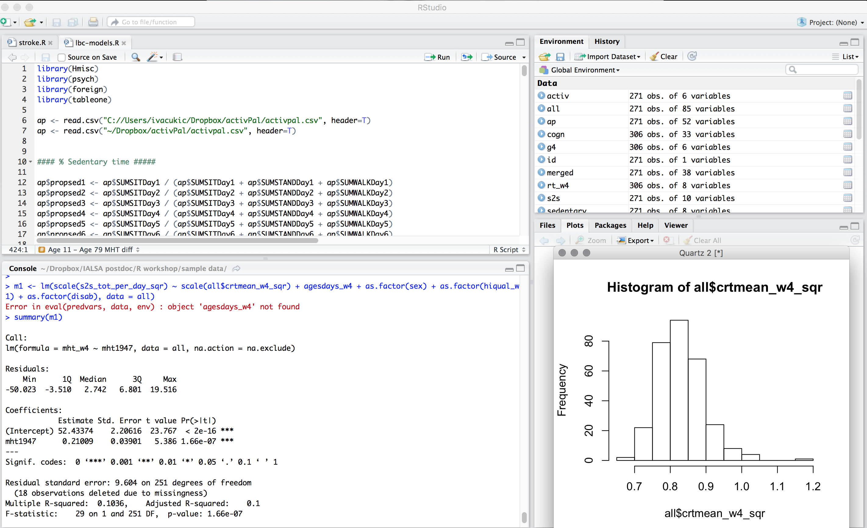

Slide 6
Structure
Scripts
text file where all your code is written
Data
spreadsheet like matrix with variables and participants
Console
where we execute our commands and see outputs
Tons more

Slide 7
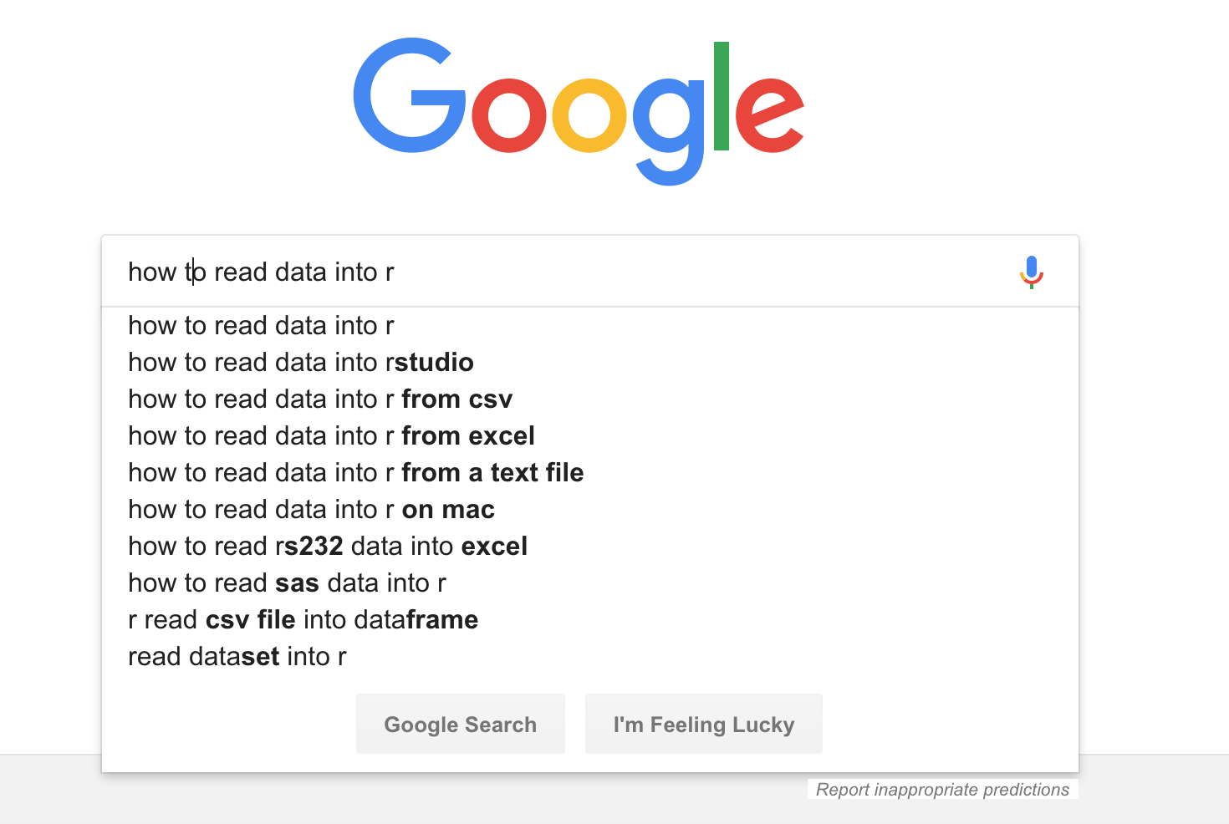
Your best friend

Slide 8
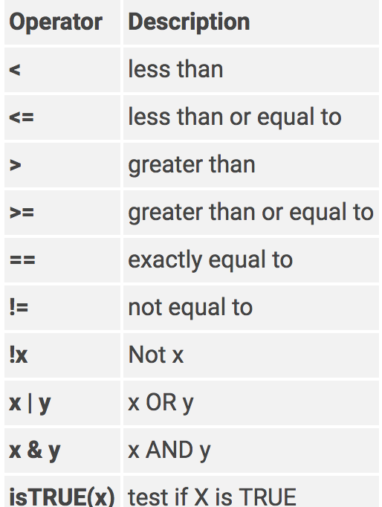
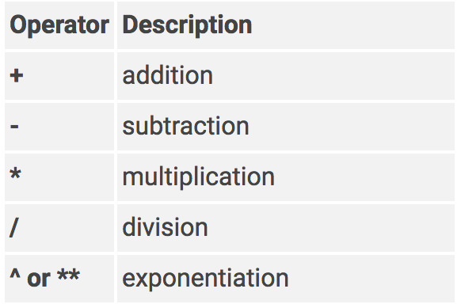
Operators
Logical
Arithmetic

Slide 9
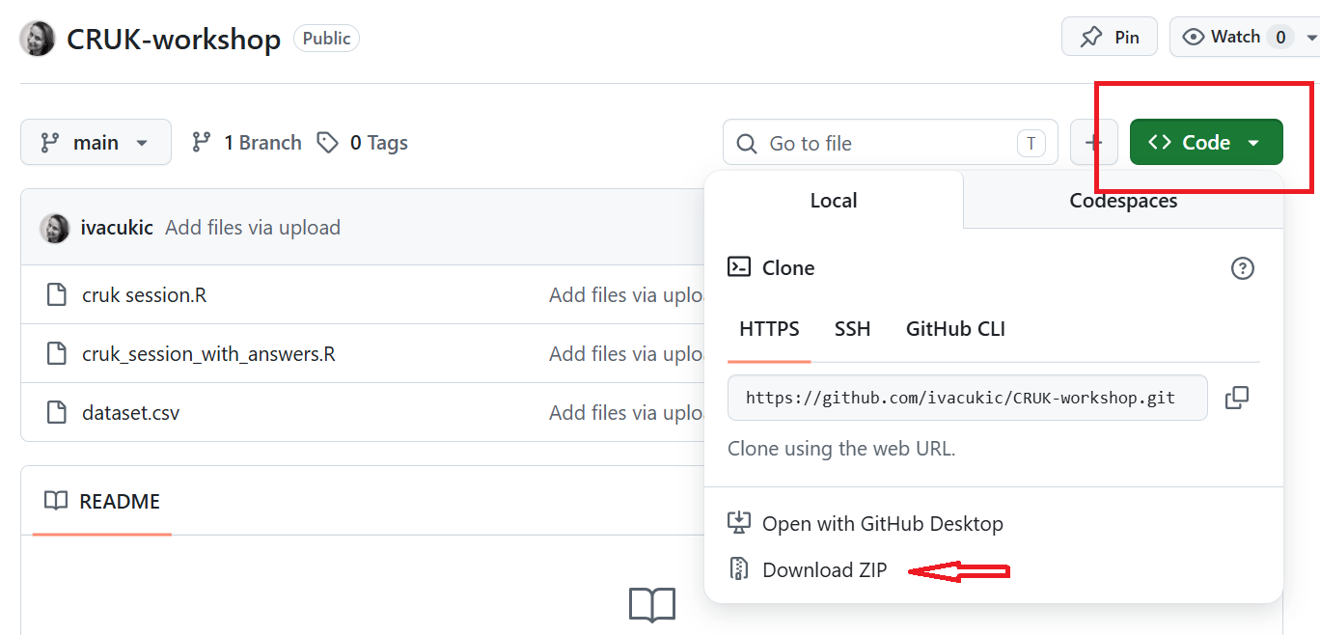
Create a folder for today’s session
Download materials:
https://github.com/ivacukic/CRUK-workshop

